Slide 1

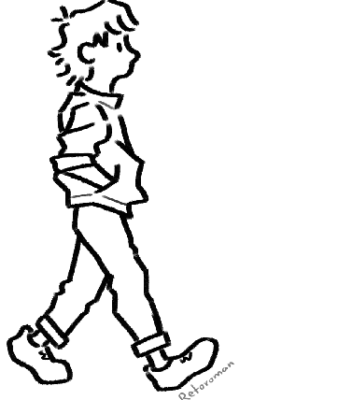
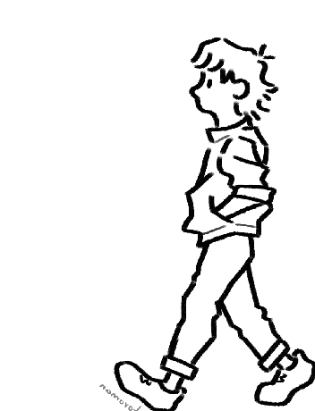
Human Gait Analysis
Submitted By : Abhishek Nijhawan , Aanchal, Anushka Chauhan
Team Name : Velocity.AI

Slide 2
Introduction
WHAT IS GAIT?
Movement/ Human Locomotion/ a person’s way of walking
Interaction of Cardiorespiratory, Musculoskeletal and Nervous systems.
Normal Gait: A series of Rythmatical alternate moments of trunk and limbs which results in forward progression of the centre of gravity. A gait is the style , manner or pattern of walking. Walking patterns may refer from individual to individual.
Gait Cycle
It is defined as the period of time from heel stride to next heel Stride of the same limbs.

Slide 3
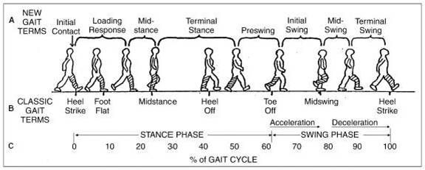
Gait cycle consists of two phases:
Stance Phase: It is a contact phase or weight bearing phase(weight on the foot).
Swing Phase: There is no contact phase or no weight bearing phase(no weight on the foot).
Stance Phase
It begins when the heel of one leg strikes the ground and ends when the toe off the same leg lifts off.
It constitutes approximately 60% of the gait cycle.
SWING PHASE :
It represents the period between toe-off or one foot and heel strike on the same foot.
It constitutes the 40% gait cycle.

Slide 4
Human gait analyser
A human gait analyzer is a specialized system or device used to assess and analyze the way a person walks or moves their limbs while walking. Gait analysis is commonly used in various fields, including healthcare, sports medicine, biomechanics research, and rehabilitation.

Slide 5
When creating an AI-based gait analysis system, the primary problem or idea being solved is the assessment and understanding of an individual's or an organism's walking or running patterns. Gait analysis is a valuable tool in various fields, including healthcare, sports science, biomechanics, and even security. Here are some key aspects of the problem being addressed:
Biomechanical Assessment: Gait analysis helps in understanding the biomechanics of human or animal locomotion. It involves analyzing the movement patterns, joint angles, forces, and timings involved in walking or running.
Healthcare: In healthcare, gait analysis can be used to diagnose or monitor conditions such as neurological disorders, orthopedic problems, and musculoskeletal diseases. It can also be employed in rehabilitation to track a patient's progress.

Slide 6
Sports Science: Gait analysis is crucial in sports science and athletics to optimize performance and prevent injuries. Coaches and athletes use it to refine running or walking techniques, select appropriate footwear, and tailor training programs.
Security and Surveillance: In security applications, gait analysis can be used for biometric identification. Just like fingerprint or facial recognition, an individual's unique gait pattern can be used for identification and authentication.
Research and Development: Researchers use gait analysis to better understand human and animal locomotion. This information is invaluable in fields such as robotics, prosthetics, and the development of assistive devices.
AI-based gait analysis leverages artificial intelligence and machine learning techniques to automate and enhance the analysis process. It can involve the use of sensors, cameras, or wearable devices to collect data on an individual's gait. AI algorithms then process this data to extract meaningful insights, detect abnormalities, and provide actionable information.

